Slide 1
Ethical Hacking
Mohona Ghosh

Slide 2
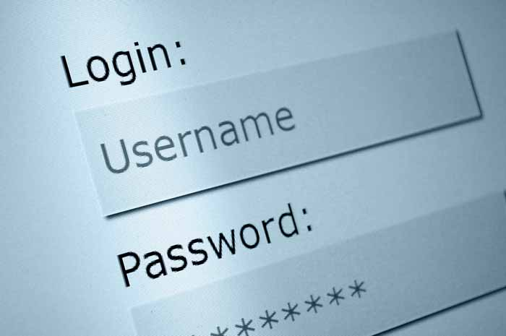
Password
The front line of defense against intruders is the password system
Most common way to prove the identity of an online user
Secret word or string of characters which is used by a user to prove her identity as an authentic user to gain access to a resource
Strong password protection technique is essential to protect the user security and identity
Notes:
Because passwords are our primary source of authentication, it is important to ensure strong password protection techniques

Slide 3
Password Protection
Two Aspects:
Client Side
Server Side

Slide 5
MOHONA GHOSH

Slide 6
Security issues with passwords (Client Side)
Vulnerability of passwords
Often users tend to choose a password that is too short or easy to guess
Common passwords pattern
Account Name followed by number
Relatives name with some delimiters
Dictionary words
License plate number
Patterns from keyboard
Only digits
Only small case
Dictionary words with white spaces deleted

Slide 7
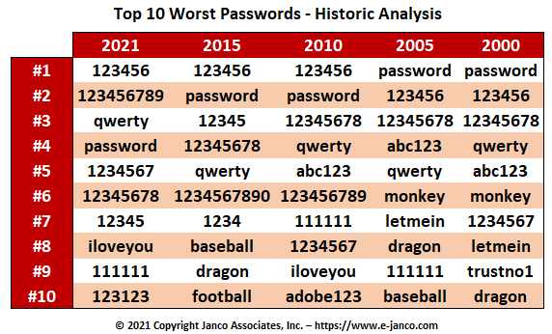
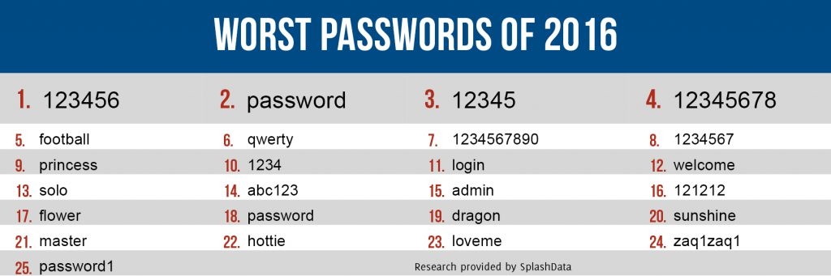
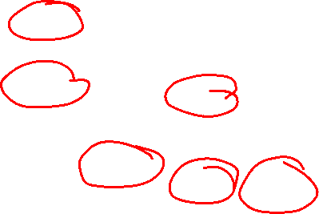
Security issues with passwords (Client Side)
Most people use real words as passwords
MOHONA GHOSH
Notes:
Using such hardware, an adversary with multiple computing units can easily try multiple different passwords in parallel

Slide 8
Security issues with passwords (Server Side)
MOHONA GHOSH

Slide 9
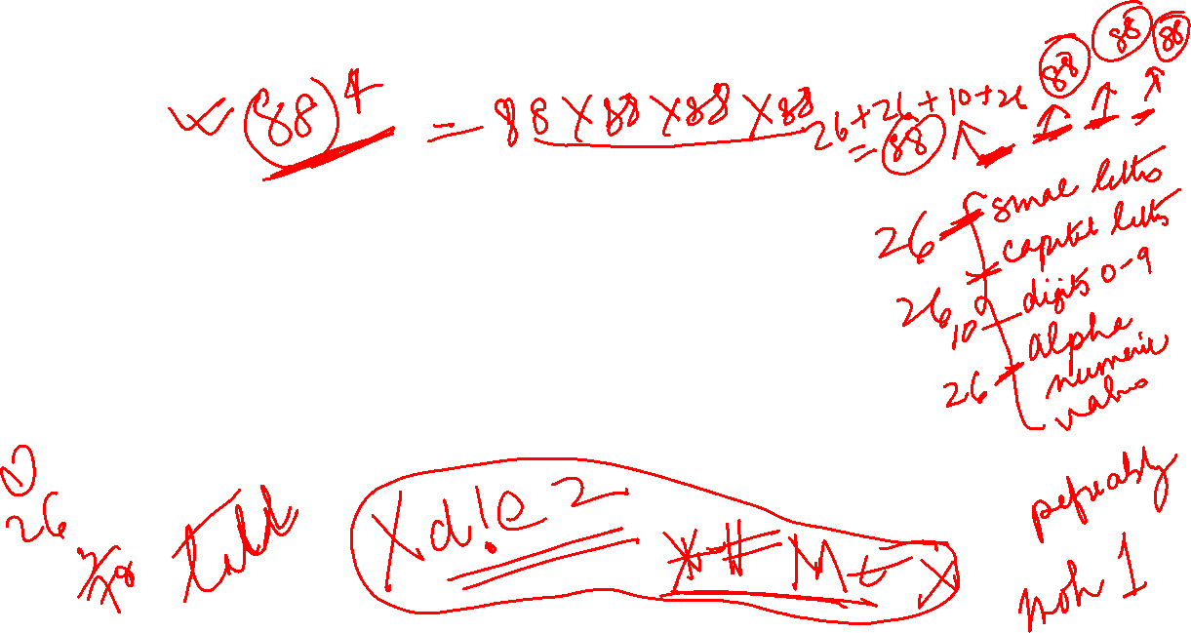

Slide 10
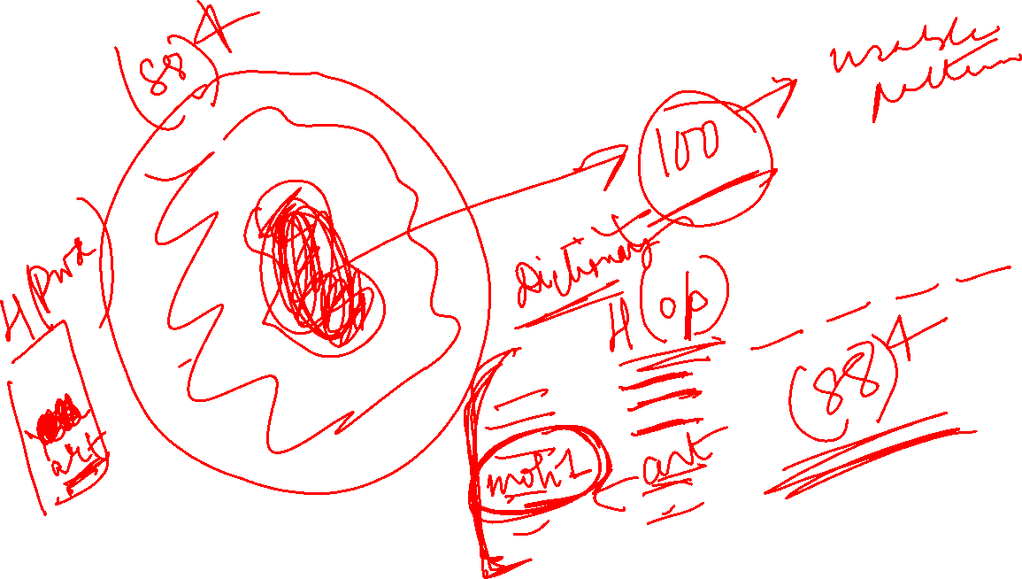

Slide 11

MOHONA GHOSH

Slide 12

In SHA 1 hash ouput is of length 160-bits
MOHONA GHOSH

Slide 13

MOHONA GHOSH

Slide 14
Dictionary Attack

Slide 15
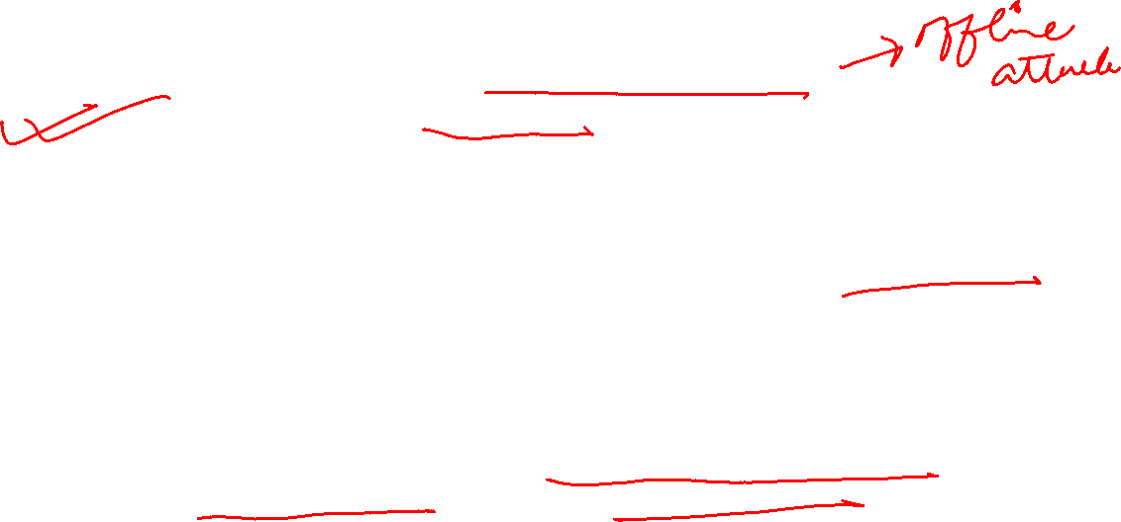
Password Cracking and Password Guessing Attack
Dictionary Attack is a type of password cracking attack
Password guessing is an online technique that involves attempting to authenticate a particular user to the system.
Password cracking refers to an offline technique in which the attacker has gained access to the password hashes or database.
Password guessing may be detected by monitoring the failed login system logs.
In order to differentiate between the normal user accidentally mistyping their passwords and the attacker, clipping levels are useful. Clipping levels define a minimum reporting threshold level.
Using the password guessing example, a clipping level might be established such that the audit system only alerts if failed authentication occurs more frequently than five times in an hour for a particular user.

Slide 16

Password Cracking and Password Guessing Attack
Preventing successful password guessing attacks is typically done with account lockouts.
Account lockouts are used to prevent an attacker from being able to simply guess the correct password by attempting a large number of potential passwords. Some organizations require manual remediation of locked accounts, usually in the form of intervention by the help desk. However, some organizations configure account lockouts to simply have an automatic reset time, which would not necessarily require manual intervention.

Slide 17
Other Password Attacks

Slide 18
Types of Password Attacks

Slide 19
Types of Password Attacks
Read about hash injection attack

Slide 20

Types of Password Attacks
Read about rainbow tables from internet

Slide 21
Types of Password Attacks

Slide 22

Various Password Cracking Tools
John the Ripper (www.openwall.com/john/)
Cain and Able (www.oxid.it/cain.html)
AirCrack (www.aircrack-ng.org)
Hashcat
Winrtgen(http://www.oxid.it)

Slide 23
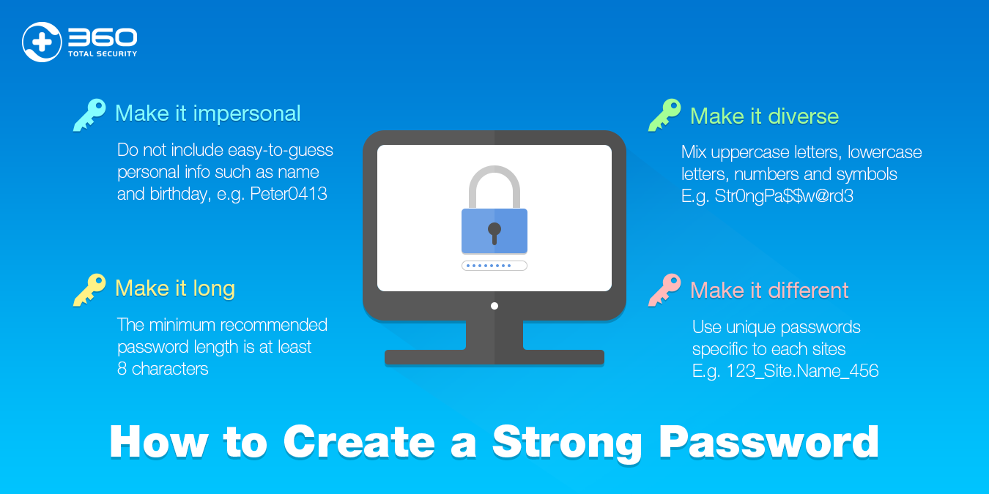
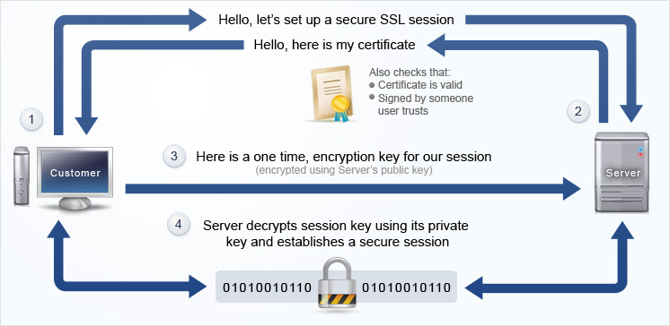

Prevention (Client Side)
Use strong password
E.g., Passphrase based password
“This little kitty went to market” -> “tlkWENT2m”
Dictionary attacks are not applicable to passphrase
based systems
Make sure the connection between the user and the email server is encrypted
Use HTTPS instead of HTTP (SSL connection)
Username and passwords are not sent in cleartext
Notes:
First and foremost protection principle that is advised to be followed is to use strong passwords so that it is not easily guessed and misused

Slide 24
MOHONA GHOSH

Slide 25
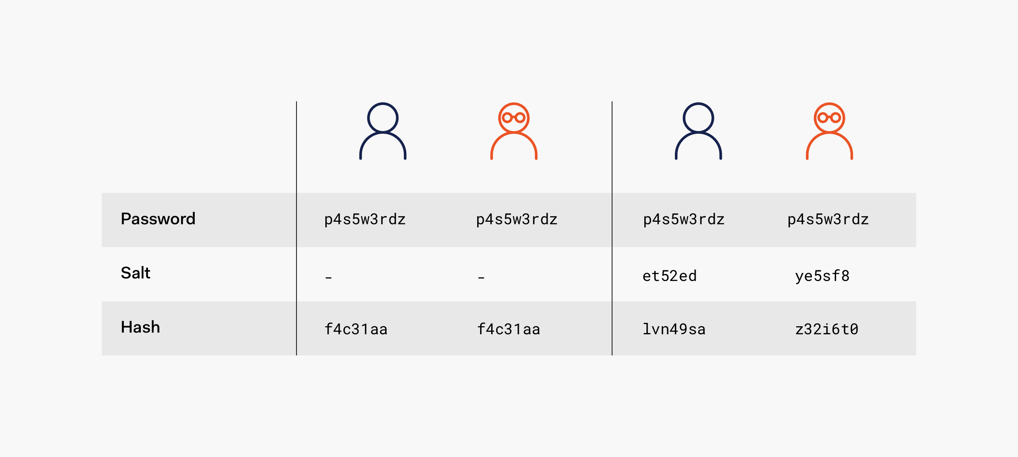

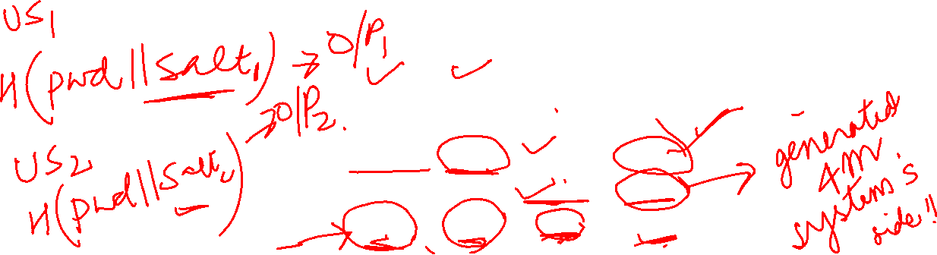
Prevention (Server Side)
Salting
A salt is a fixed-length cryptographically-strong random value that is added to the input of hash functions to create unique hashes for every input, regardless of the input not being unique

Slide 26

Prevention (Server Side)
Hashed passwords are not unique to themselves due to the deterministic nature of hash function: when given the same input, the same output is always produced
If Alice and Bob both choose “@IGdTuW” as a password, their hash would be the same
Through dictionary attack, if attacker is able to legitimately map a particular hash to one password then, once the password is known, the same password can be used to access all the accounts that use that hash.
Use of salt prevents such attacks….

Slide 27
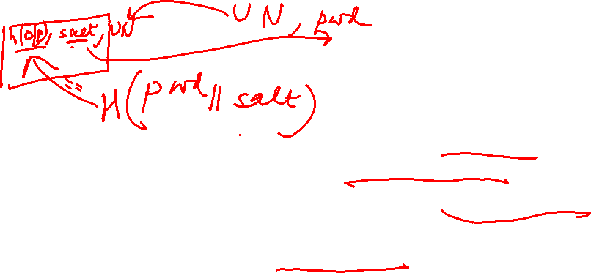
Prevention (Server Side)
A salt makes a hash function look non-deterministic, which is good as we don't want to reveal password duplications through our hashing
For each password input, append a 12-bit random salt to the password and then input to the hash function
For each user generate a different salt
If someone looked at the full list of password hashes, no one would be able to tell that Alice and Bob both use the same password.
The salt is stored in cleartext along with the hash in the database
When the user logs in, the username is looked up in the database, append the salt to the provided password, hash it, and then verify if the stored hash matches the computed hash

Slide 28
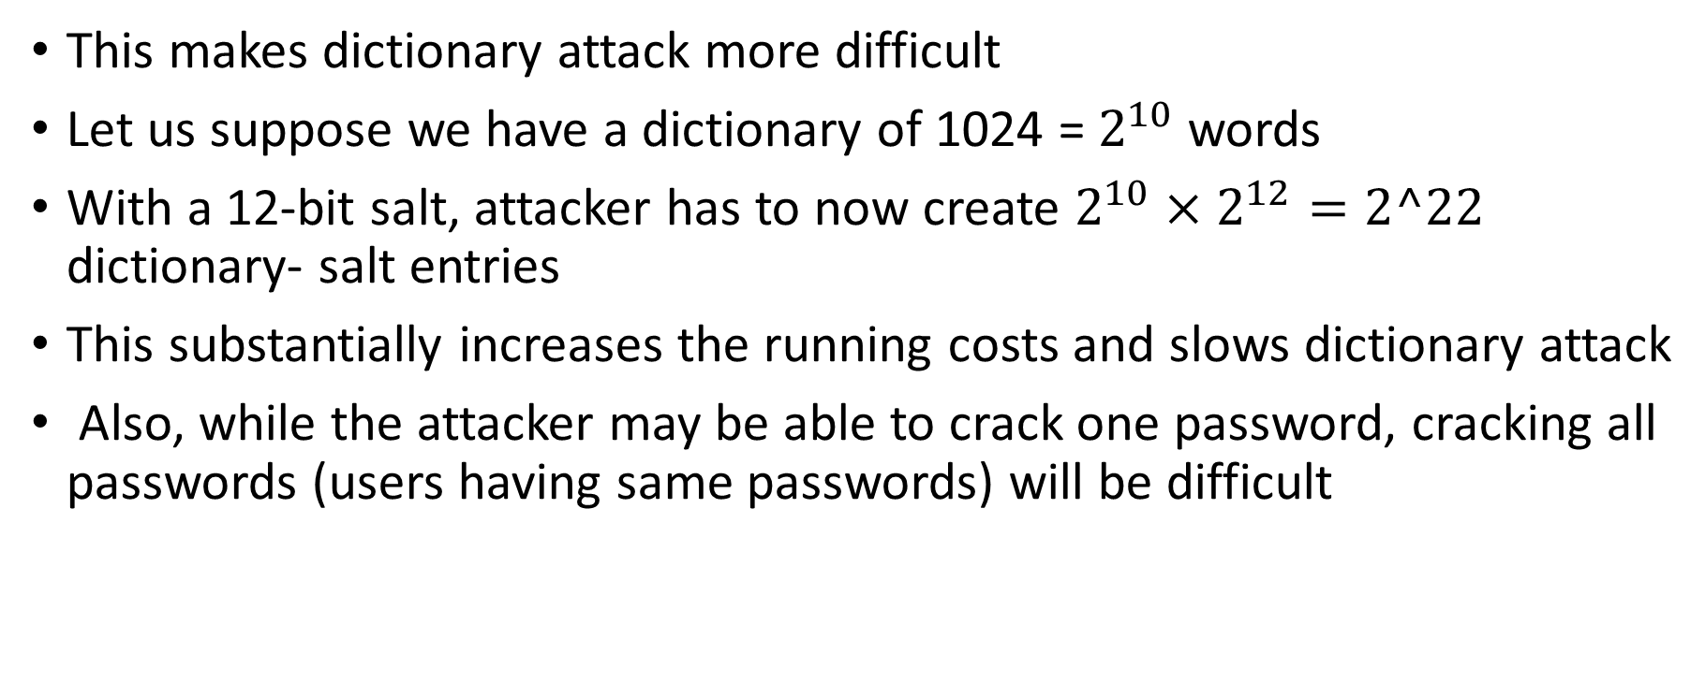
Prevention (Server Side)
This makes dictionary attack more difficult
Let us suppose we have a dictionary of 1024 = $2^{10}$ words
With a 12-bit salt, attacker has to now create $2^{10}×2^{12}=2^22$ dictionary- salt entries
This substantially increases the running costs and slows dictionary attack
Also, while the attacker may be able to crack one password, cracking all passwords (users having same passwords) will be difficult

Slide 29
Prevention (Server Side)
Memory consuming Password Hashing Scheme

Slide 30
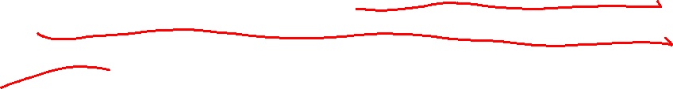
Prevention (Server Side)

Slide 31

Example
Adversary with a NVidia Tesla K20X (GPU)
2688 cores operating at 732 MHz
6 GB of shared DRAM, with a bandwidth of 250 GB/s
PHS takes 2 ms to run
Adversary can test 2688 passwords every two ms → 1,344,000 passwords tested/second, or 4,838,400,000 = 2^{32.17} per hour
If the PHS requires 20 MB of DRAM, the maximum number of cores used simultaneously becomes 300 (6GB/20MB), 11% of the total available
Parallel computation speed reduces significantly !!!

Slide 32

Prevention (Server Side)

Slide 34
CAPTCHA
The conventional text passwords are by far the main means of authentication and they will continue to be popular as they are easy to deploy and to use.
However, they have been largely exposed to different kind of attacks like guessing, dictionary attacks, phishing and key-logger attacks.
Therefore, there is a need to create an additional layer of security over the passwords for user authentication
Thus, comes into picture the need of CAPTCHAs

Slide 35
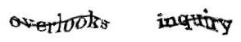
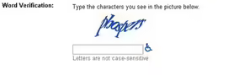

CAPTCHA
Completely Automated Public Turing test to tell Computers and Humans Apart
The goal:
To create an automated test that is easy for a human to pass but difficult for a computer
Is a type of security measure known as challenge-response authentication.
CAPTCHA helps protect us from spam and password decryption by asking you to complete a simple test that proves you are human and not a computer trying to break into a password protected account.
Optical character recognition (OCR) is a difficult problem for computers to solve
Take advantage of the fact that humans are good at recognizing patterns that computers have trouble with
A CAPTCHA test is made up of two simple parts: a randomly generated sequence of letters and/or numbers that appear as a distorted image, and a text box. To pass a the test and prove your human identity, simply type the characters you see in the image into the text box.
The most common form of CAPTCHAs are images of text that are distorted:

Slide 36
Applications of CAPTCHA
Protect website registration
Online Polls
Prevent comment spam on blogs
Prevent worms and spam
Search engine bots
Prevent dictionary attacks

Slide 37
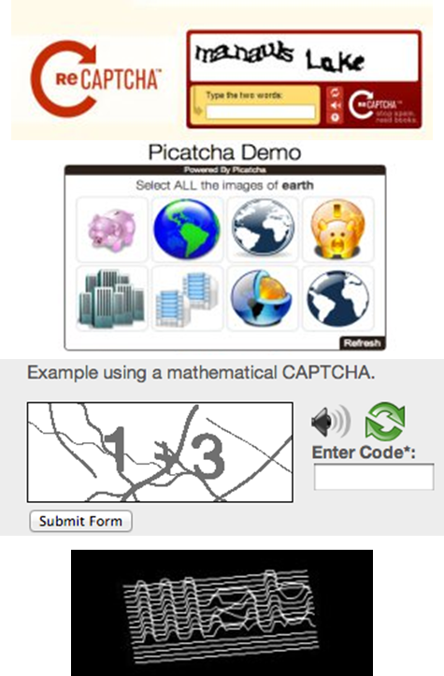
Examples of different types of CAPTCHA
Distorted text with audio option
Picture identification
Simple Math CAPTCHA
3D CAPTCHA

Slide 38
ReCAPTCHA
Developed by Luis von Ahn, Ben Maurer, Colin McMillen, David Abraham, and Manuel Blum at CMU
Acquired by Google in September 2009
Assists in digitizing the text of books
Requires user to enter two words
One is the test word that is known by the system
The other is a word from the scan of a digitized text that a computer was unable to recognize
Used to digitize the archives of the New York Times and books from Google Books

Slide 39
CAPTCHA ATTACKS
Images that use undistorted text or a consistent font are vulnerable
Image processing techniques are able to read the text if it is not distorted enough
Some companies sell CAPTCHA breaking services
Employ actual humans to solve CAPTCHAs as a job
https://en.wikipedia.org/wiki/CAPTCHA#Circumvention

Slide 40
Common Prevention Strategies

Slide 41
Common Prevention Strategies

